Slide 1

Computational Logic Exercises
Module I – Introduction
Vincenzo Maltese

Slide 2
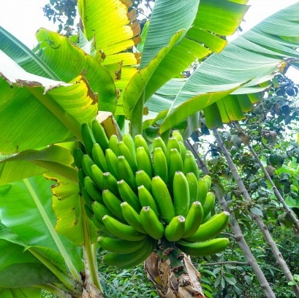
Preamble: from perception to knowledge (I)
We use perception to detect objects, their properties and relations between them.
Example: through our senses (in this case only the sight) we can detect that in the picture there are green (property) bananas (objects) growing (relation) on a tree (object).
However, we understand that they are bananas from the sensory interpretation of raw data.
Example: the shape of these objects is curve and their color is green. We can measure curves in degrees. Our eyes transform light into electrical impulses; we can detect the degree of the fundamental colours red (R), green (G), and blue (B).

Slide 3
Preamble: from perception to knowledge (II)
We communicate what we see using language.
Example: (English) “I have seen green bananas on a tree”
(Italian) “Ho visto delle banane verdi su un albero”
We accumulate the results of our experience in terms of knowledge.
Example:
Bananas grow on trees.
Bananas are fruits.
Bananas grow in clusters.
Bananas are edible.
Bananas are curve.
Green bananas are unripe
Yellow bananas are ripe.

Slide 4

Preamble: heterogeneity in language
Ambiguity (lack of formality) is when a sentence may be interpreted in more than one way due to ambiguous sentence structure (due for instance to grammar, or polysemy).
Example : Time flies like an arrow
Time passes fast, as fast as an arrow travels
OR
Measure the speed of flies like you would measure the speed of an arrow
OR
"Time flies" could refer to a specific kind of flies
OR
"like" can be seen as an adjective (similar to) o as a verb (prefer, enjoy)
OR
…

Slide 5
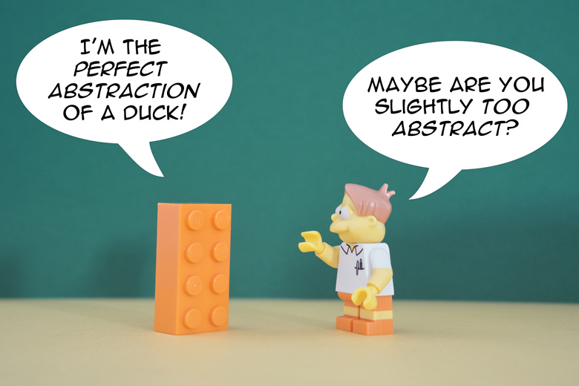
Preamble: heterogeneity in knowledge
Partiality is the fact that every description only captures part of the observed phenomenon. Knowledge about the observed phenomenon must be necessarily partial. Example: there is no way to fully describe the content of the class; you necessarily need to focus on some aspects of it and omit others.
This is also known as semantic gap, i.e. the fact that there is a loss of meaning when you describe the phenomenon.
Abstraction is when you describe the observed phenomenon by focusing on the aspects that are important for the task at hand. For instance, in case we need to describe vehicles for the purpose of measuring traffic on the highway we do not need to keep track of their color or their manufacturer. Such features are instead important for a car seller. This leads to different \ heterogeneous descriptions of the same observed phenomenon.
https://thevaluable.dev/abstraction-type-software-example/

Slide 6
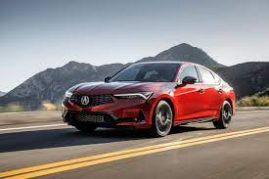
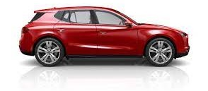


Preamble: summary
Individual descriptions of the world (conceptualizations made explicit in language and knowledge) may differ even significantly from one another due to the way our perception works and the way we abstract it as a function of our goals and different background.
As a result, it is hard to find an agreement among us about the observed world (that we codify as general statements and data) and the conclusions we collectively make through the act of reasoning.

Slide 7
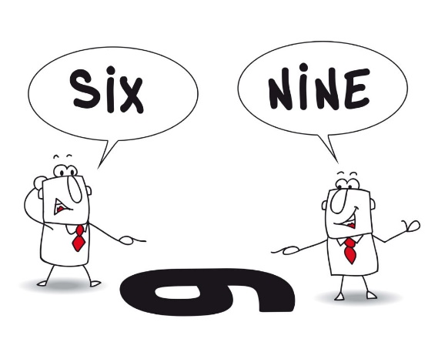
Describing the world: key questions (I)
Why it can be so difficult to find an agreement between individual persons in describing the same observed phenomenon?
ANSWER: BECAUSE OF THE INHERENT DIVERSITY OF PEOPLE, THEY GENERATE DIFFERENT MODELS OF THE SAME OBSERVED PHENOMENON.

Slide 8
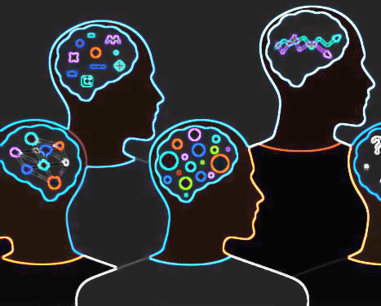
Fallacies: cognitive bias (I)
Anchoring bias: Relying too much on the first piece of information you learn or hear
EXAMPLE: IF YOU ARE CONVINCED THAT ALL BANANAS ARE YELLOW, YOU WILL FAIL IN RECOGNIZING BANANAS OF OTHER COLOURS AS BANANAS.
Confirmation bias: Listening to and trusting only information that confirms your beliefs
EXAMPLE: CONSPIRACY THEORIES
Blind-spot bias: Recognizing bias in others, but failing to recognize it in yourself
EXAMPLE: PEOPLE OFTEN DO NOT RECOGNIZE THAT THEIR THINKING IS BIASED BY THE CULTURE OF THE PLACE WHERE THEY ARE BORN

Slide 9
Fallacies: cognitive bias (II)
Negativity bias: Focusing on negative events at the expense of positive or neutral events
EXAMPLE: IF YOU FAIL IN SOMETHING, YOU NEVER TRY AGAIN (STORY OF THE OLD ELEPHANT THAT CANNOT ESCAPE FROM A SMALL CHAIN THAT WAS ENOUGH TO STOP HIM WHEN HE WAS YOUNG)
Outcome bias: Judging or evaluating a decision based solely on the outcome
EXAMPLE: AN INVESTOR DECIDES TO INVEST IN REAL ESTATE AFTER LEARNING A COLLEAGUE MADE A BIG RETURN ON AN INVESTMENT IN REAL ESTATE WHEN INTEREST RATES WERE AT A DIFFERENT LEVEL.

Slide 10
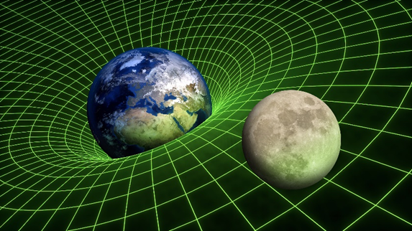
Fallacies: map-territory confusion (I)
EXAMPLE 1: The general relativity theory by Albert Einstein explains gravitation in physics but does not necessary correspond to how it works in the reality

Slide 11

Fallacies: map-territory confusion (II)
EXAMPLE 2: The menu is a representation of what you can eat but it is not what you will eat

Slide 12
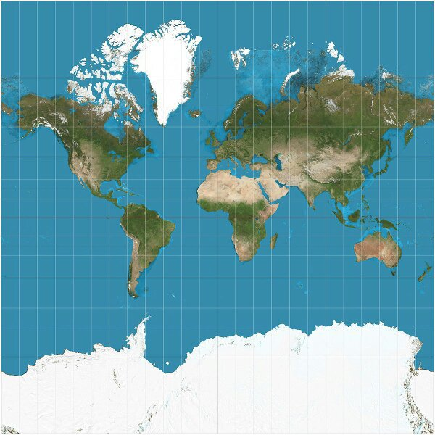
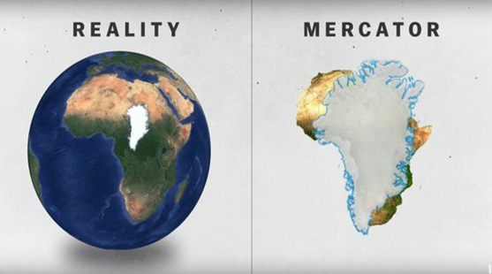
Fallacies: map-territory confusion (III)
EXAMPLE 3: All geographical maps represent territories with certain known limits: Every map grapples with making Earth, a spherical planet, appear to scale in two dimensions. But the most well-known version today — called the Mercator projection — drastically distorts the size of many countries. On the Mercator map, shown on the left, Greenland appears almost the same size as Africa. In reality, as it is shown on the right, Greenland only covers about 1/14 of Africa.

Slide 13
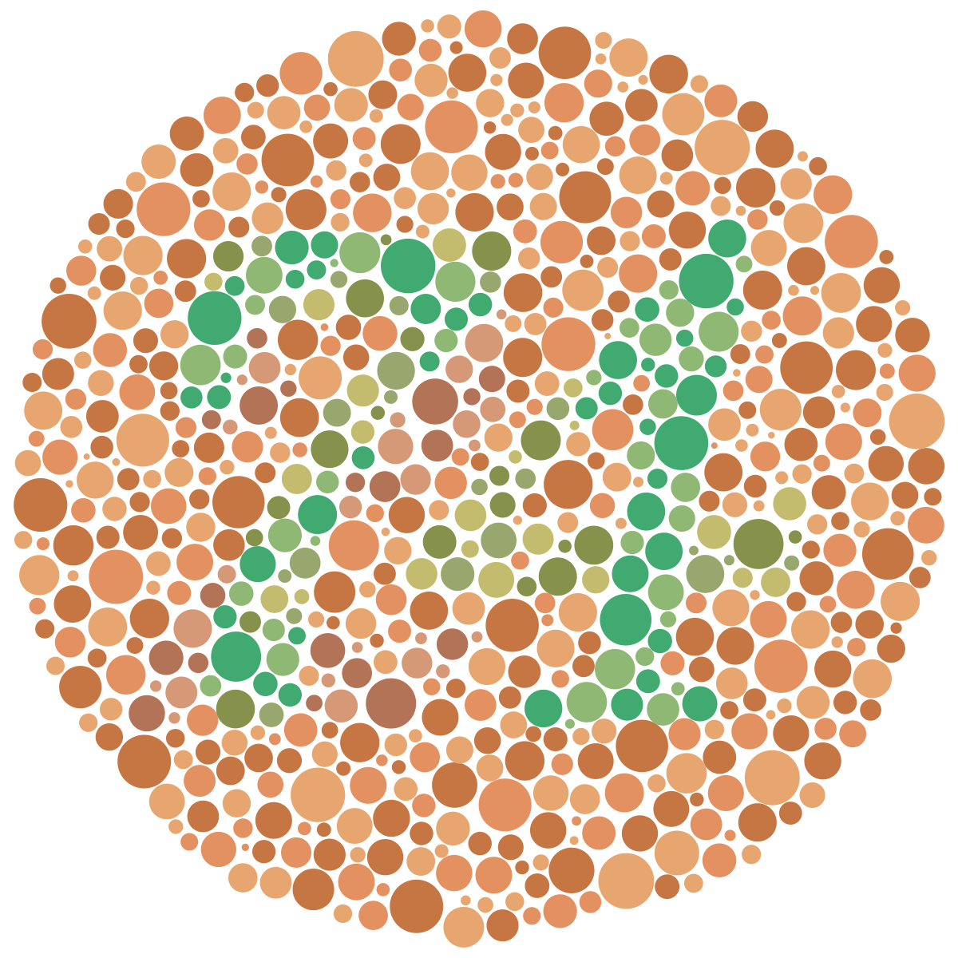
Limits in perception and modelling (I)
Provide an example of limits of our senses in perceiving the world
EXAMPLE (Sight): We can only see a certain range of colors. Also, we need the light to be bright enough to see things.
EXAMPLE (Hearing): Humans, animals and even some insects have a range of wavelengths or pitches they can sense or hear. Within this range, there is also a minimum and maximum volume that can be heard.
https://www.school-for-champions.com/senses/limits.htm

Slide 14
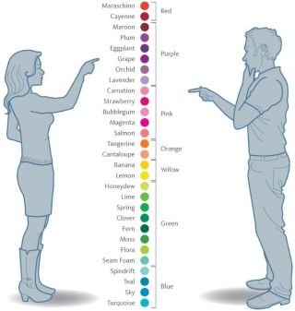
Limits in perception and modelling (II)
Provide examples of limits in modelling posed by approximation
EXAMPLES
Speed of car
Body temperature
Color of an object
…

Slide 15
Limits in perception and modelling (III)
Provide examples of SEMANTIC GAP (i.e. the fact that there is a loss of meaning when you describe the phenomenon)
EXAMPLE 1: When modelling the problem of estimating the time needed by a car to travel from one location to another, we can just concentrate on its speed (no need to consider color, model, weight …)
EXAMPLE 2: When modelling the problem of representing students’ performance, we can just concentrate on their scores on exams (no need to consider hair color, gender, nationality, …)
EXAMPLE 3: When modelling weather forecast, we cannot represent all aspects of the entire Planet Earth

Slide 16
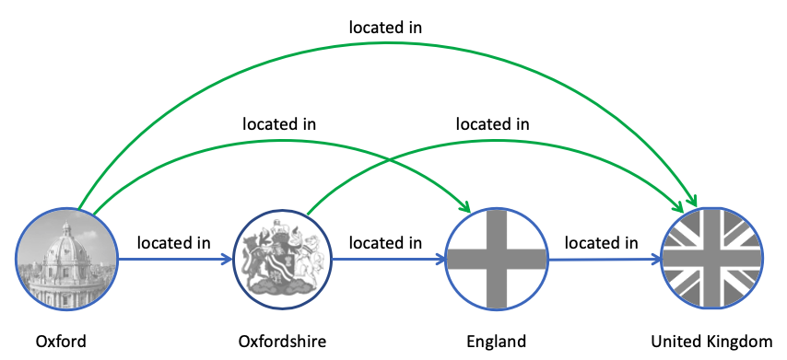
The notion of reasoning
In general, from a computational point of view, reasoning is the process by which we infer new knowledge from what we know already.
Premises
Oxford is located in Oxfordshire. Oxfordshire is located in England.
England is located in United Kingdom.
Conclusion
Therefore, Oxford is located in United Kingdom.

Slide 17
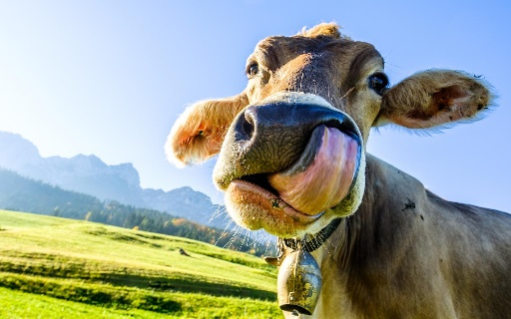
Deductive reasoning
Deductive reasoning is a form of reasoning where conclusions follow logically from premises.
Premises
All cows eat grass
Camilla is a cow.
Conclusion
Camilla eats grass.

Slide 18
Inductive reasoning
Inductive reasoning is a form of reasoning where conclusions follow from limited observations, by the process of generalization.
Premises
Camilla and Viktor are cows.
Camilla and Viktor eat grass.
Conclusion
All cows eat grass

Slide 19
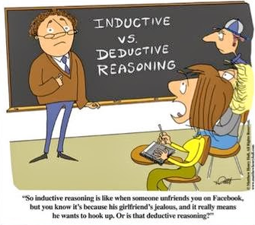
Reasoning (I)
Can inductive reasoning generate mistakes?
ANSWER: YES, BECAUSE PREMISES ARE BASED ON PARTIAL OBSERVATIONS.
Can deductive reasoning generate mistakes?
ANSWER: NO IF PREMISES ARE TRUE AND WE ASSUME A CLOSED WORLD.

Slide 20
Test yourself (I)
Which of the following sentences about PERCEPTION is true?
Perception is an error-free process
Perception can give us a complete understanding of the observed phenomenon
We use perception to detect objects, their properties and relations between them
We reason about a certain phenomenon by means of perception
ANSWER: c

Slide 21
Test yourself (I)
Which of the following sentences about AMBIGUITY in natural language is false?
A sentence in natural language might be ambiguous because of the multiple ways it can be interpreted grammatically
A certain degree of ambiguity is unavoidable in natural languages
A sentence in natural language might be ambiguous because of the presence of words that have synonyms
Polysemy generates ambiguity
ANSWER: c

Slide 22
Homework (I)
Answer to the following questions
Why, in modelling, it is so important to consider the role of perception?
What is the relation between our senses and the way we describe the world?
What is the role of abstraction in describing the world?
What exactly we focus on when we describe a phenomenon?
What are the limits of a natural language in describing the world?
What kind of tools can be used to codify a language and the meaning of its words?
What is knowledge?
What is the fundamental goal of reasoning?
Is reasoning an error-free process?
Can you describe some of the typical pitfalls in reasoning?

Slide 23
Homework (II)
Provide examples about the following types of fallacies:
Optical illusion (characterized by a visual percept that arguably appears to differ from reality)
Cognitive bias (systematic patterns of deviation from norm and/or rationality in judgment)
Map - Territory confusion (when someone confuses the semantics of a term with what it represents.)
Correlation/causation fallacy (when people believe that correlation equals causation)
Bandwagon fallacy (if many people agree on the same point, it must be true)
Anecdotal evidence fallacy (rather than using hard facts, people base their arguments on their own experiences)
Proof fallacy (you assume something is true simply because there is no evidence against it)

Slide 24
Representing the world: key questions
What are the consequences of the semantic gap when representing a certain phenomenon? Are there also positive consequences?
ANSWER: GIVEN THAT IT IS NOT POSSIBLE TO FULLY REPRESENT A PHENOMENON, WE MUST FOCUS ONLY ON THE RELEVANT ASPECTS FOR THE TASK AT HAND, AND EVEN IN THIS CASE WE CAN ONLY CONCENTRATE ON SOME OF THE FEATURES WITH A CERTAIN DEGREE OF APPROXIMATION. A POSITIVE CONSEQUENCE IS THAT BY FOCUSING ON THE KEY FEATURES, APPROPRIATELY SELECTED, WE CAN LIMIT COMPLEXITY OF REASONING WITH A REASONABLE APPROXIMATION OF CORRESPONCENCE WITH THE REAL WORLD.

Slide 25
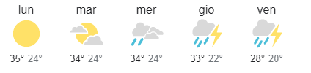
Analogical and linguistic models (I)
By abstraction come up with both a linguistic and an analogical model of the following phenomenon: Weather of the week for the purpose of forecasting
ANALOGICAL MODEL
LINGUISTIC MODEL (IN ITALIAN)
“Lunedì cielo sereno, ma il tempo peggiorerà nella settimana passando a nuvoloso martedì e molto nuvoloso i giorni successivi fino a venerdì con forti temporali ed un progressivo abbassamento delle temperature.”

Slide 26
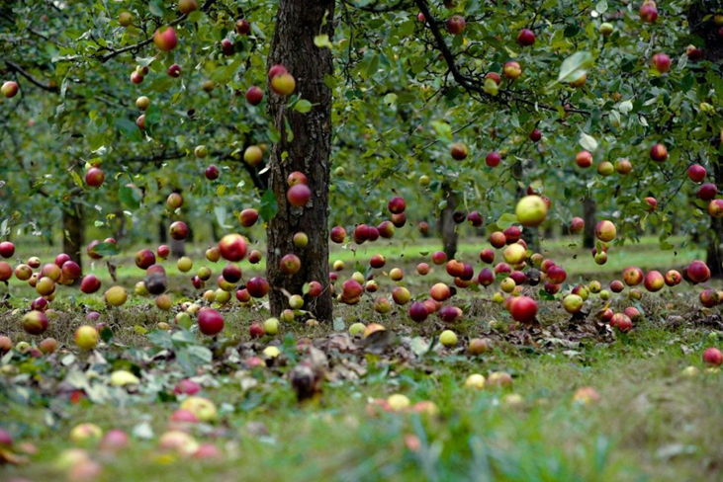
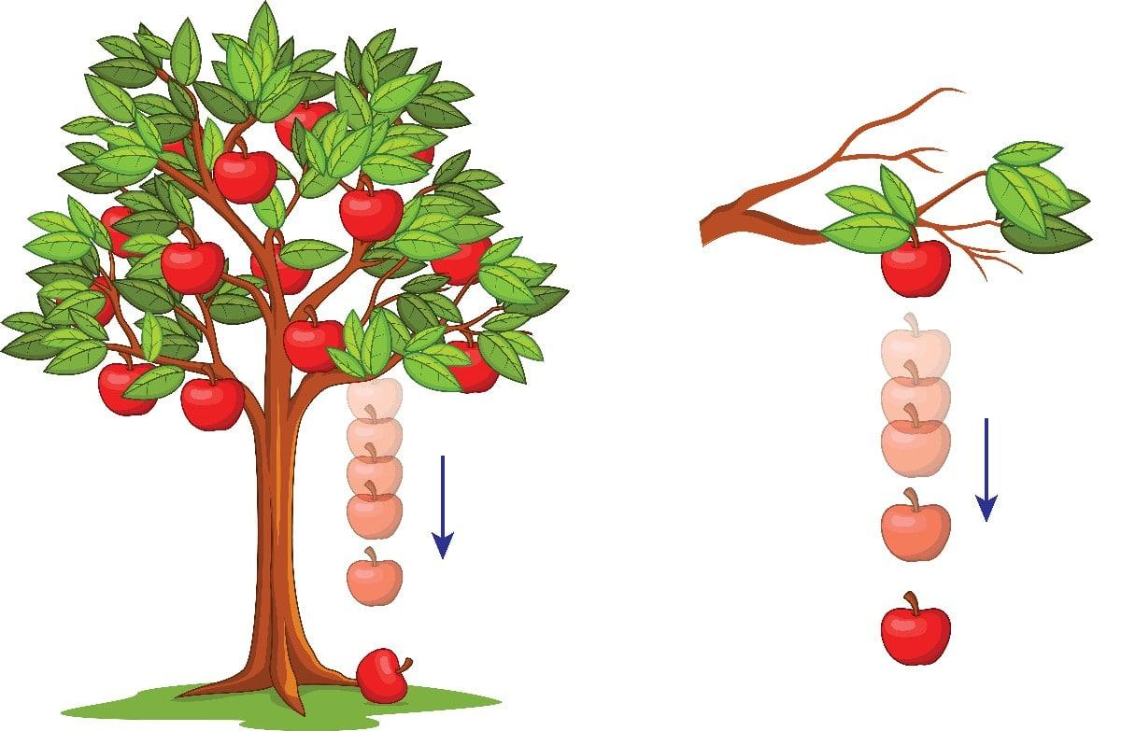
Analogical and linguistic models (II)
Given the models below say if they are coherent with the observed phenomenon
“apples fall form trees”
“apples can be eaten”
“the reason why an apple falls from its tree is that the apple is attracted by Earth”
.
ANSWER: coherent models are: a, d

Slide 27
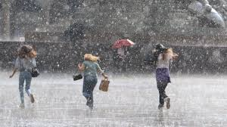
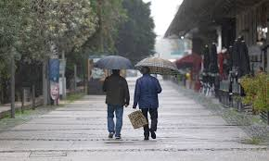
Analogical and linguistic models (III)
Given the observed phenomenon, say which of the following are good examples of semantic gap: Weather, for the purpose of modelling human behavior
the number of people observed is irrelevant
we cannot count the exact number of rain drops
there is no need to describe the actions of people
the color of umbrellas is irrelevant
OBSERVATION#1
ANSWER: a, b, d
OBSERVATION#2

Slide 28



Analogical and linguistic models (IV)
Given the previous observed phenomenon, say which of the following are good examples of models
e)
(#1) “it rains heavily, and 3 persons with no umbrella are running to avoid to get wet”;
(#2) “it rains softly, and 2 persons with umbrella are walking quietly”;
f)
g)
ANSWER: e, f (NOTE: g is false because in #1 they run and do not have umbrella)

Slide 29
Analogical and linguistic models (V)
Given the previous observed phenomenon, say which of the following are good examples of theories
h)
“if it rains heavily, people with no umbrella must run to avoid to get wet”;
“if it rains softly, people with umbrella can walk quietly”;
i)
“female like running when it rains”;
“male like walking when it rains”;
j)
“if it rains heavily, people always run to avoid to get wet”;
“if it rains softly, people still need an umbrella to avoid to get wet”;
ANSWER: h, i
NOTES: about i, there might be multiple interpretations of human behavior, depending on the observations; about j, the modeler fails to recognize that only people with no umbrella are running, regardless the intensity of rain

Slide 30
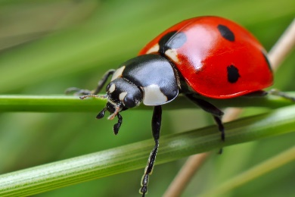
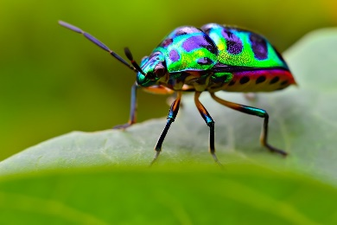
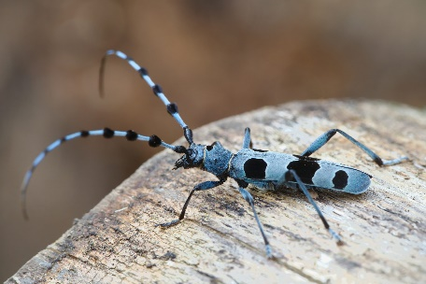
Design models and theories from observations (I)
Design plausible linguistic models from the following observations
Examples of possible models for the 3 different observations:
#1: the insect is red with black spots of circular shape; the insect has three pairs of jointed legs and one pair of antennae;
#2: the insect is multicolour with several spots of different shape; the insect has three pairs of jointed legs and one pair of antennae;
#3: the insect is pale blue with several black spots of different shape; the insect has three pairs of jointed legs and one pair of antennae;

Slide 31
Design models and theories from observations (II)
Design a complete theory from the following models
Examples of possible theories derived from the 3 observations:
#1: insects have spots, three pairs of jointed legs and one pair of antennae;
#2: insects can be of different colors with several spots of different shape;
#3: insects have one pair of antennae;

Slide 32
Design models and theories from observations (III)
Design a complete theory from the following models
M1: cure A worked with patient 1 affected by disease X; patient 1 is male
M2: cure A worked with patient 2 affected by disease X; patient 2 is male
M3: cure A did not work with patient 3 affected by disease X; patient 3 is female
POSSIBLE ANSWER:
cure A works on male patients affected by disease X;
cure A does not work on female patients affected by disease X

Slide 33
Test yourself (I)
Say which of the following theories is complete, i.e. denotes all the sentences of the following models
M1: Alice lives in Trento; Alice is 1,65m tall; Alice is female
M2: Bob lives in Bologna; Bob is 1,89 tall; Bob is male
M3: Sam lives in Trento; Sam is 1,75m tall; Sam is male
T1: Males are taller than females;
T2: in Trento and Bologna, males are taller than females;
T3: People only live in Trento or Bologna; In Trento all people are male; People is at least 1,65m tall
T4: Trento and Bologna are in Italy; People is at least 1,65m tall, regardless whether they are male or female
ANSWER: T2 and T3
NOTE: T1 is partial
NOTE: T4 is partial and also not correct w.r.t. the models as it mentions Italy

Slide 34
Test yourself (II)
How many analogical and linguistic representations you can derive from a single observed phenomenon?
exactly one
infinite
zero
it depends on the phenomenon
ANSWER: b

Slide 35
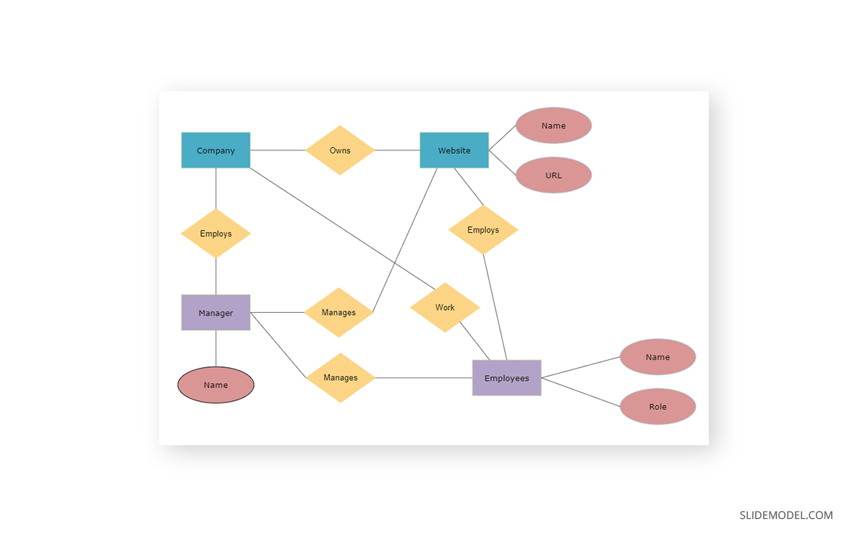
Use ER diagrams as a language for theories
Translate the following theory into an ER diagram
Each company own a website. A website is characterized by a name and a URL. Each company employs a manger who manages both the website and the employees that work for the company. Both the manager and the employees have a name. Employees occupy specific roles within the company.
POSSIBLE ANSWER

Slide 36
Homework (I)
Answer to the following questions
What is the role of abstraction in computer science?
How many analogical and linguistic representations you can derive from a single observed phenomenon?
What is the relation between heterogeneity and interoperability?
What kind of interoperability do you know and which of them Is the MOST expensive to achieve?
What is the relation between a theory and its models?
What is the semantics of a sentence of a theory?
Can you think about the advantages of correct and complete theories?
Are complete theories always desirable?
Can you summarize the process by which from the observation of the world you construct models and a theory such that you can reason about It?

Slide 37
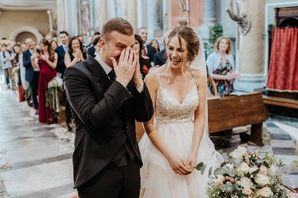

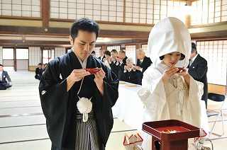
Homework (II)
EXERCISE 1: Given the observations below, come up with corresponding linguistic representations, compare them with those designed by a colleague and discuss differences and possible reason of differences.

Slide 38
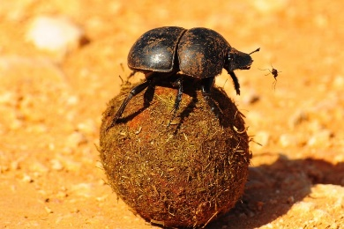
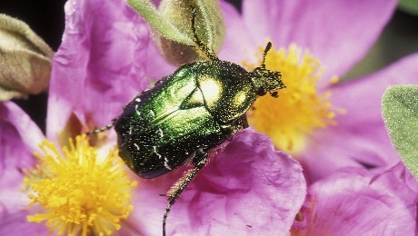
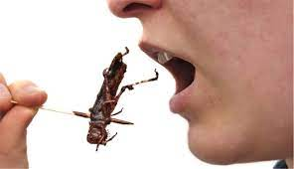
Homework (III)
EXERCISE 2: Given the observations below, come up with corresponding linguistic representations, compare them with those designed by a colleague and discuss differences and possible reason of differences.

Slide 39
Homework (IV)
EXERCISE 3: Invent one exercise for each of the following types, send it to one of your colleagues and discuss together about the answer provided by the colleague
Start from a phenomenon and a specific task and by abstraction come up with both a linguistic model and an analogical model
Given a linguistic or analogical model say if it is coherent with a given observed phenomenon
(multiple choice questions) - Given an observed phenomenon, say which of the following are good examples of semantic gap / representations / models / theories
Design linguistic models starting from different observations of the same phenomenon
Design a complete theory from a set of models of an observed phenomenon
(multiple choice questions) - Say which of the following theories is complete, i.e. denotes all the sentences of the following models
(multiple choice questions) – come up with possible answers for the key questions; in each group 3 answers are false and one is true (or vice versa)
Use ER diagrams as a language for designing a theory for an observed phenomenon (the number of observations may vary from one to three)

